Slide 1

JavaScript Reimagined

Slide 2
Agenda
Introduction • What • Why • How

Slide 3
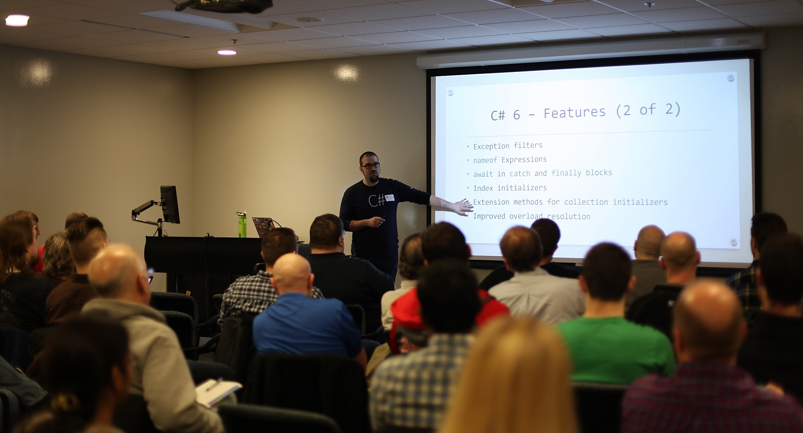







David Pine { @davidpine7 } < Technical Evangelist />
http://davidpine.net
https://github.com/ievangelist
https://www.linkedin.com/in/dpine
http://stackoverflow.com/users/2410379/david-pine

Slide 4
What
What is TypeScript?

Slide 5
First things first, JavaScript
First appeared on May, 23 1995
Dynamic, untyped and “interpreted” (compiled) language
It is actually named “ECMAScript”, but no one calls it that
It is the worlds third most common programming language (SQL and Java are more popular)

Slide 6
JavaScript was originally developed in 10 days by Brendan Eich
https://en.wikipedia.org/wiki/JavaScript
Well…
that explains a lot!

Slide 7
JavaScript was intended for 100 - 1,000 lines of code. Now with regularity, applications are 100,000 - 1,000,000 lines of code!
Anders Hejlsberg
JavaScript was simply not designed to scale.

Slide 8


TypeScript
Introduced on Oct, 1st 2012
Created by Microsoft’s Anders Hejlsberg
Anders, the original author of Turbo Pascal and the chief architect of Delphi. Currently works as the lead architect of C# and is a core developer on TypeScript
Notes:
Microsoft offered $500,000.00 and stock options, but Borland counter-offered. Finally Microsoft doubled their offer, and Anders was given a $1,000,000.00 signing bonus!!

Slide 9
TypeScript: JavaScript that scales
A typed superset of JavaScript that compiles to JavaScript
TypeScript files have the *.ts file extension
Backwards compatibility to ECMAScript 3 (ES3)
Any browser, any host and OS
Modern (Node.js and Visual Studio/Code Tooling)
Open Source
Supports Latest JavaScript features

Slide 10

DEMO
Notes:
main.js … from JavaScript to TypeScript

Slide 11
Why
Why TypeScript?

Slide 12
The feature gap
ES2015
ES2016
ES2017
ES2018
ES3
ES5
JavaScript Evolution
State of web JS
State of server JS
State of the art JS
Target
Productivity
JavaScript feature gap

Slide 13
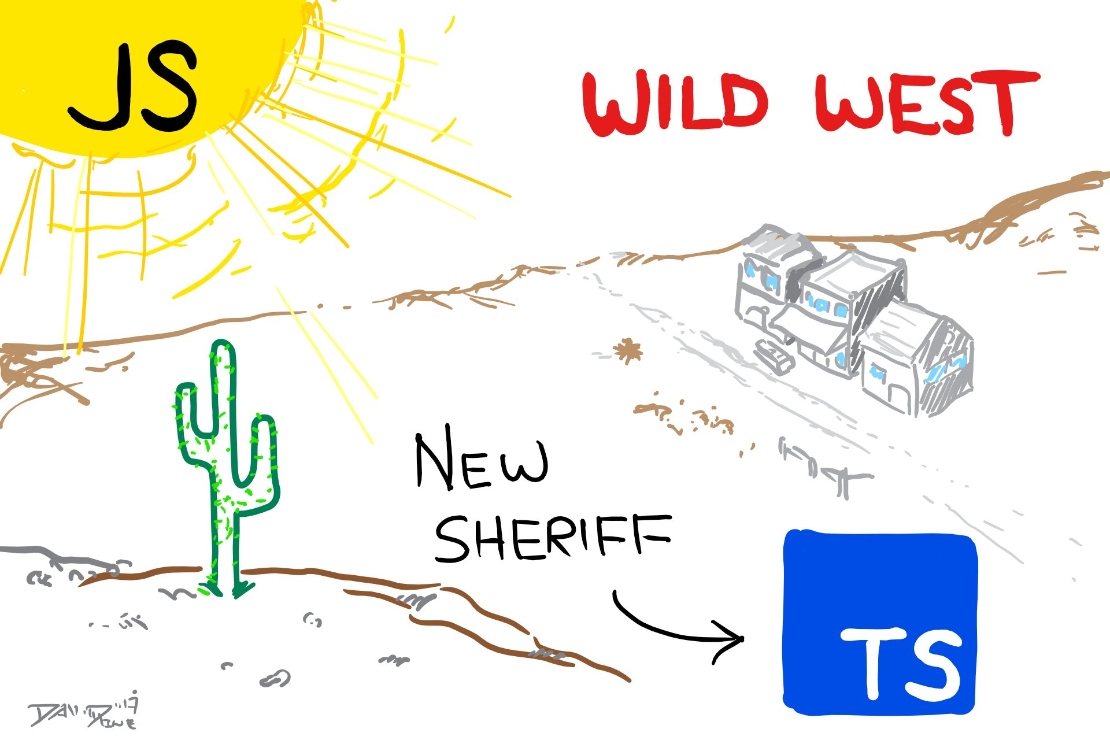

Slide 14
5) Compatibility
JavaScript is standardized through the ECMAScript standards, unfortunately not all browsers in use support all features of newer ECMAScript standards
ES6 / ES2015, ES2016, ES2017 or ESNext Features
Backwards compatible all the way to ES3
Notes:
TypeScript is a true superset, any and all JavaScript *.js files are valid TypeScript

Slide 15
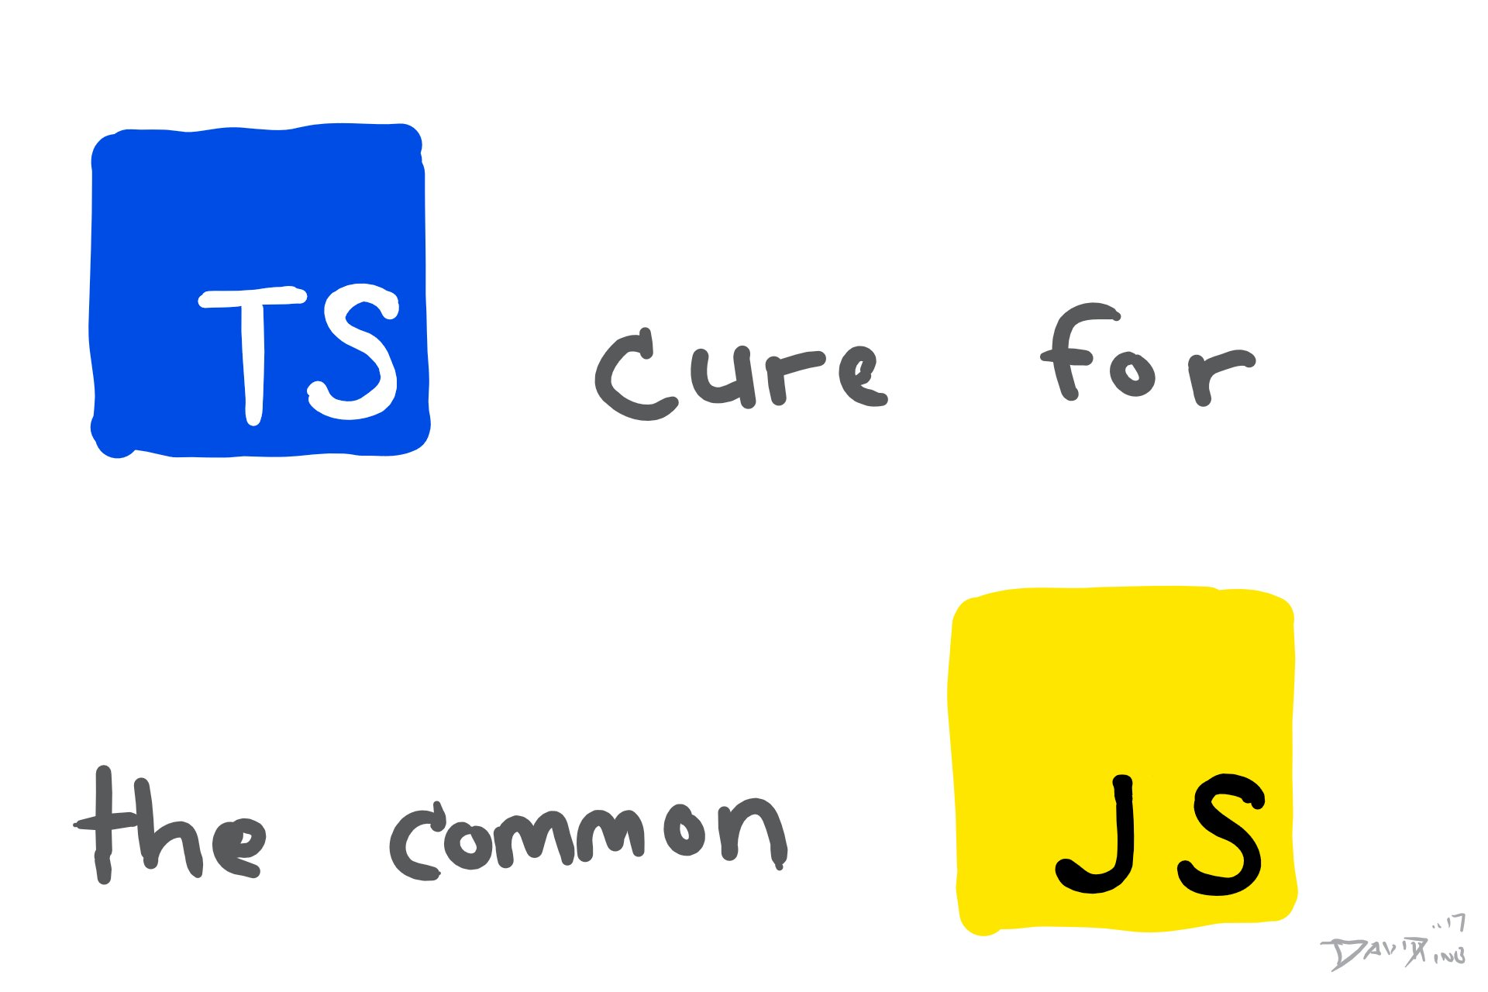

Slide 16
4) Tooling
Language Service (First class citizen)
Documentation (JSDoc)
Statement / Code completion
Refactoring
Not just Visual Studio / Code

Slide 17








Supported Tooling
Visual Studio
Sublime Text
Atom
WebStorm
Visual Studio Code
Eclipse
Emacs
Vim

Slide 18
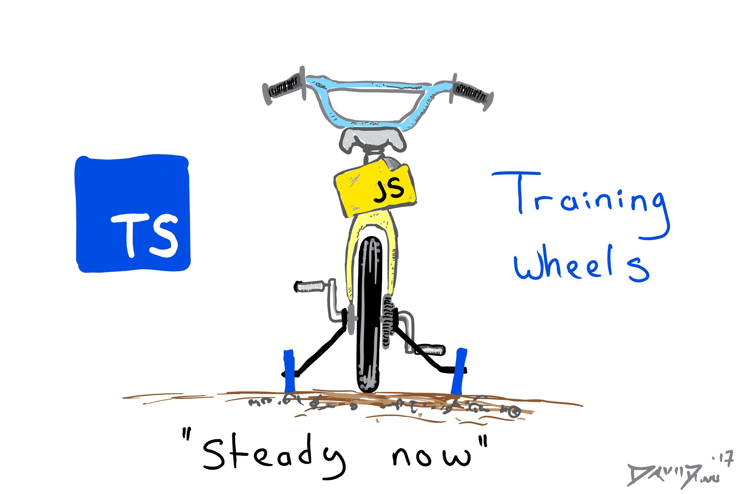

Slide 19
3) Open Source
View the inner workings (source code)
Post issue(s)
Propose new features
Contribute, be an OSS developer
https://github.com/microsoft/TypeScript
Notes:
OSS is NOT the future of software… It is the NOW.

Slide 20
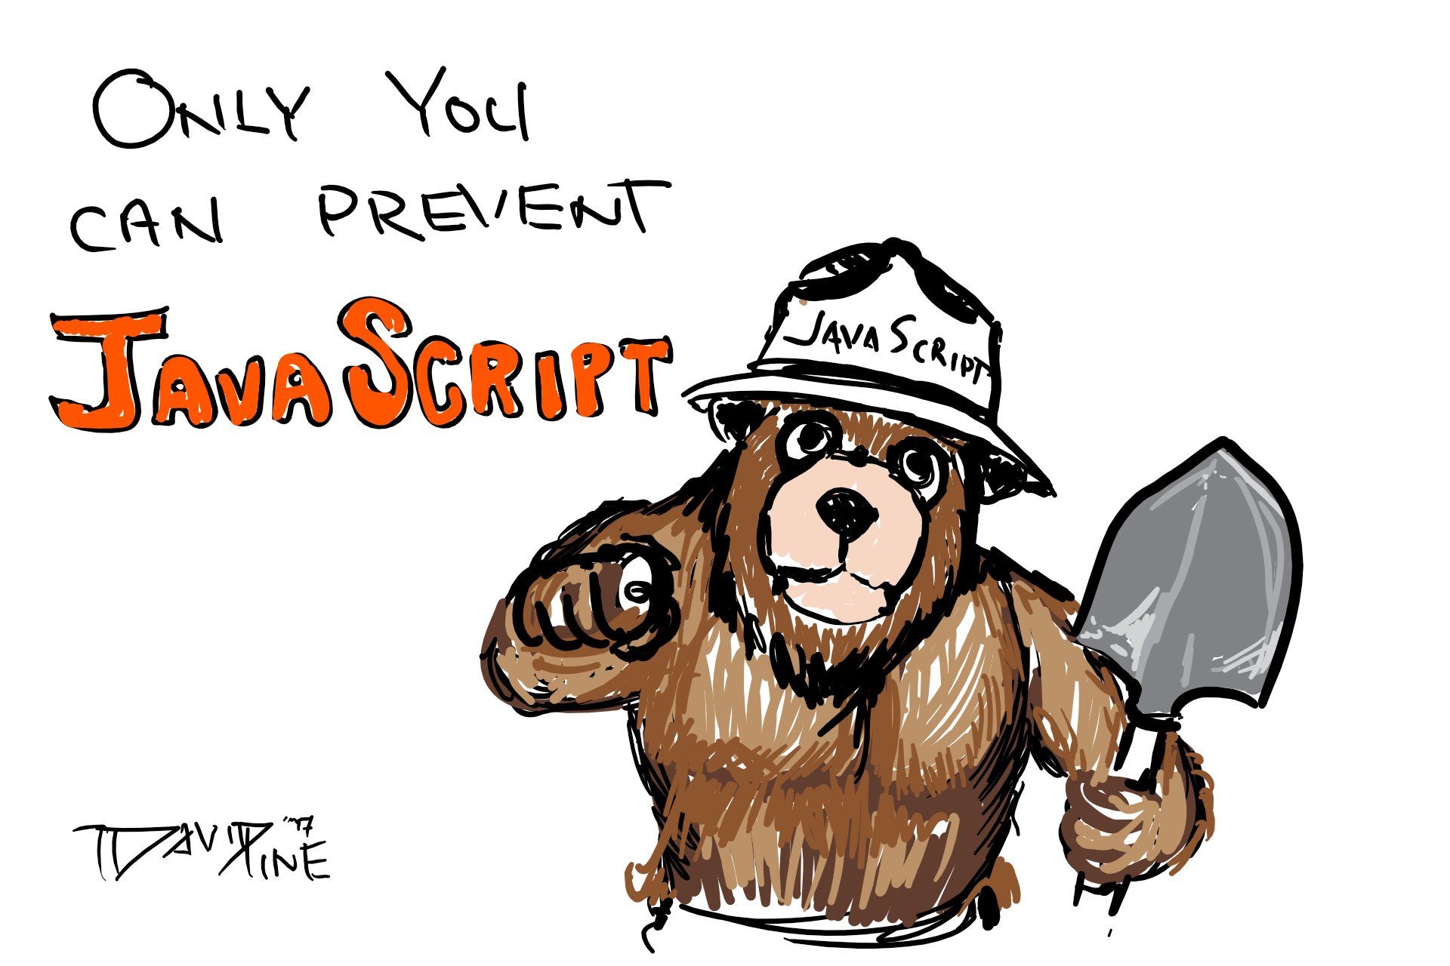

Slide 21
2) Static Typing / Type System
Basic Types
Advanced Types
Classes, Interfaces and Abstract classes
Generics
Type Assertions, Type Guards and Type Aliases
Polymorphic this

Slide 22
1) Compilation
Earliest point of failure
Compile errors are actually you’re friend
Removes the “training wheels”

Slide 23
How do you comfort a Javascript Bug
You console it

Slide 24
Peripheral reasons
Google’s Angular is written (and documented for consumption) in TypeScript
The emergence of the SPA
Familiarity, both JavaScript and C# developers will quickly get used to the syntax

Slide 25
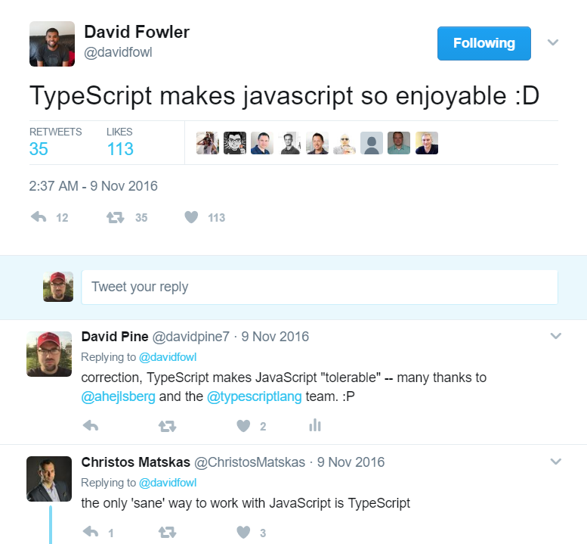

Slide 26
DEMO
Notes:
Playground demo… enums, animals with generics

Slide 27
When a Javascript Date has gone bad
Don’t call me, I’ll callback
you… I promise!

Slide 28
How
How to “TypeScript”

Slide 29
Basic Types
boolean
true / false
number
supports decimal, hex, binary and octal literals
string
template support with `${}` syntax, single '' or double quotes "" (as expected)

Slide 30
Basic Types
array
let l: number[] = [ 1, 2, 3 ];
tuple
const t: [number, string] = [ 32, 'Dave' ];
enum
enum Example { Foo, Bar };

Slide 31
Basic Types
any
let notSure: any = 4;
notSure = "maybe a string instead";
notSure = false; // okay, definitely a boolean
void
null or undefined

Slide 32
Basic Types
never
function error(message: string): never {
throw new Error(message);
}
function infiniteLoop(): never {
while (true) { }
}

Slide 33
DEMO

Slide 34
File Extensions
*.ts
*.d.ts
*.map
*.js

Slide 35
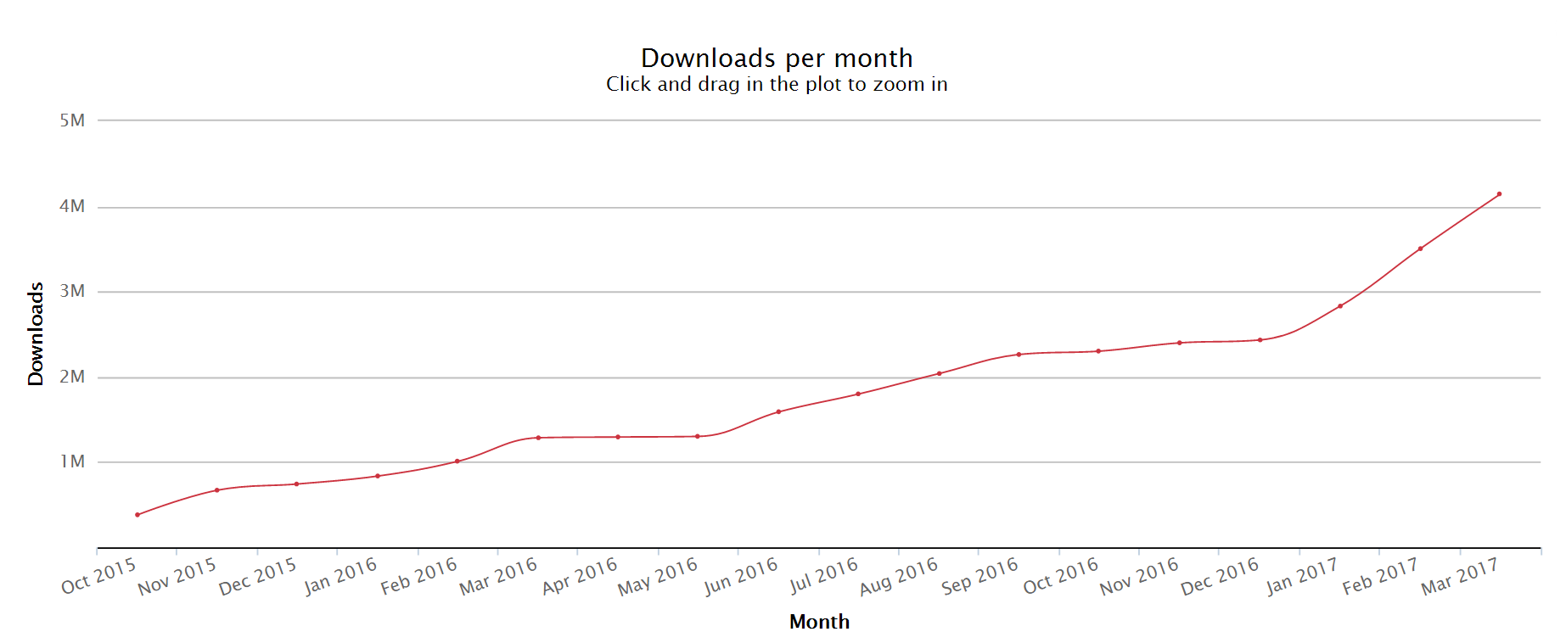
Adoption

Slide 36
Thank You
@davidpine7
http://davidpine.net
https://github.com/ievangelist

